Slide 1
Visual Knowledge Transfer among Multiple Cameras for People Counting
Presenter: Yen-Yu Lin (林彥宇)
Research Center for IT Innovation, Academia Sinica

Slide 2
Outline
Introduction
Previous work
Our approaches
Cross-camera blob matching
Two-pass regression
Experiments and results
Conclusions

Slide 3
Outline
Introduction
Goal of people counting
Motivation & idea of our approach
Previous work
Our approaches
Cross-camera blob matching
Two-pass regression
Experiments and results
Conclusions
Notes:
This is the outline of my today`s presentation.
First, I will brief previous work.
Next, I will introduce our approaches, including two parts: cross-camera blob matching and two-pass regression.
Then, I will present our experiments and results.
Finally, I will give conclusions.

Slide 4
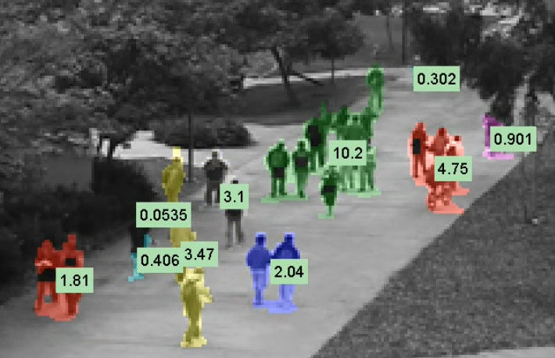
The goal of people counting
Estimate the number of pedestrians in a video frame
Applications
- Video content analysis - Video surveillance
- Traffic monitoring - Advertisement evaluation
- Adaptive device control for energy saving

Slide 5
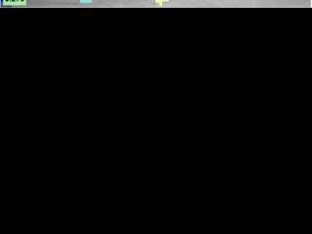
A demo

Slide 6
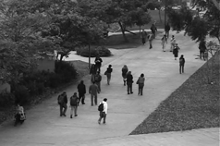
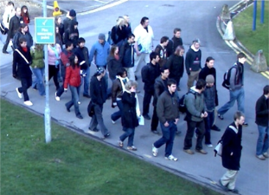
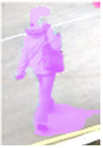
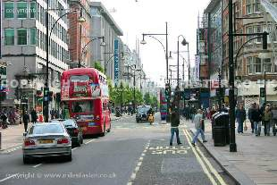

Challenges of people counting
clutter backgrounds
real-time processing
low resolution
occlusions
shadows

Slide 7
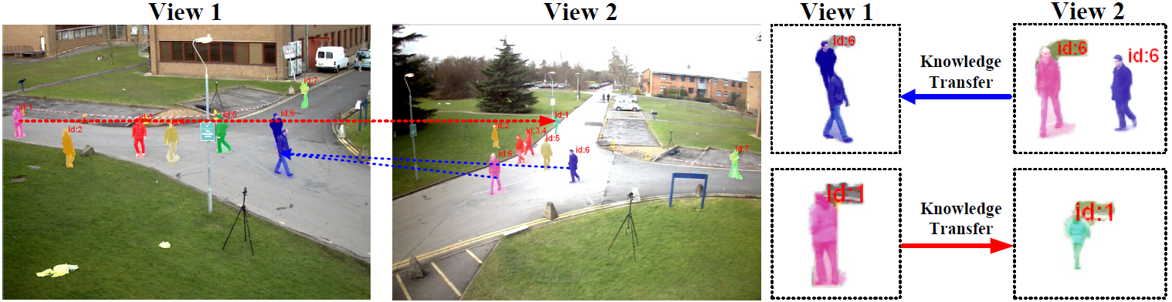
People counting with multiple cameras
Why multiple cameras?
Complementary information
Our approach
Blob matching + Visual knowledge transfer

Slide 8
Outline
Introduction
Previous work
Counting-by-detection
Counting-by-regression
Multiview people counting
Our approaches
Cross-camera blob matching
Two-pass regression
Experiments and results
Conclusions

Slide 9
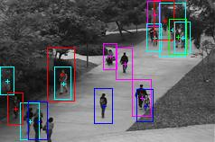
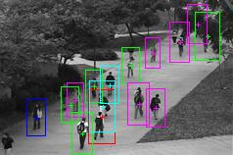
Counting-by-Detection
Explicitly locating the position of each pedestrian and then counting
Pros
Robust to variations in illumination, poses, and …
Cons
A great number of training samples required
High computational complexity at detection stage
Sensitive to partial occlusions or low image qualities
Notes:
The first category is counting-by-detection.
Methods of this category determine the number of people by explicitly locating the position of each individual pedestrian and then counting the total number of detected ones.
These approaches are robust to variations caused by different illumination, poses, image sizes, and so on.
Although these methods work well in controlled environments, they probably result in suboptimal performance in a more general setting.
This is because most approaches in this category cannot clearly define the appearance or the shape of pedestrians in advance.
Furthermore, these methods require a great number of training samples and their computational complexity is high at detection stage.
In addition, this class of methods are unreliable for those pedestrian with partial occlusions or of low resolutions.

Slide 10
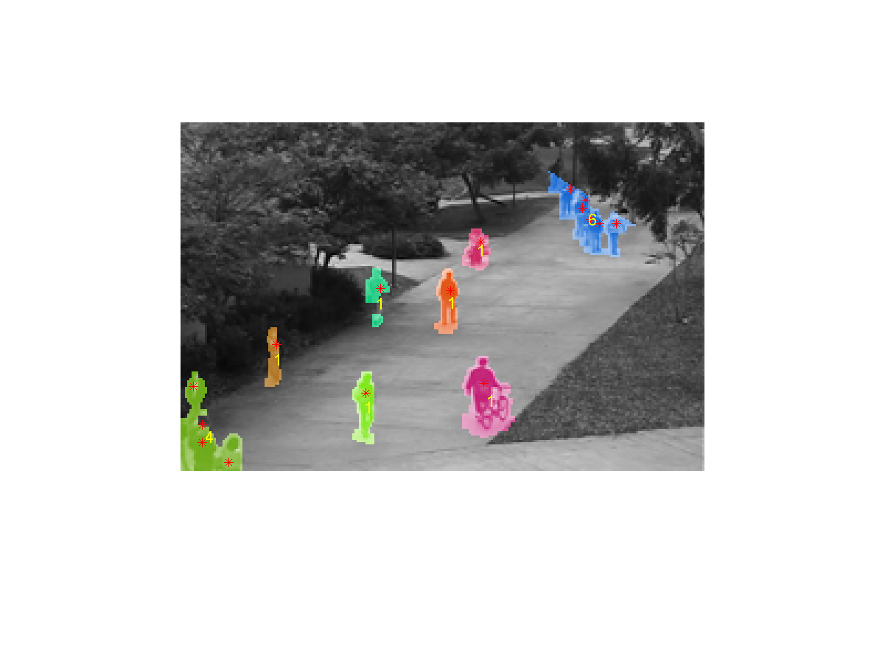
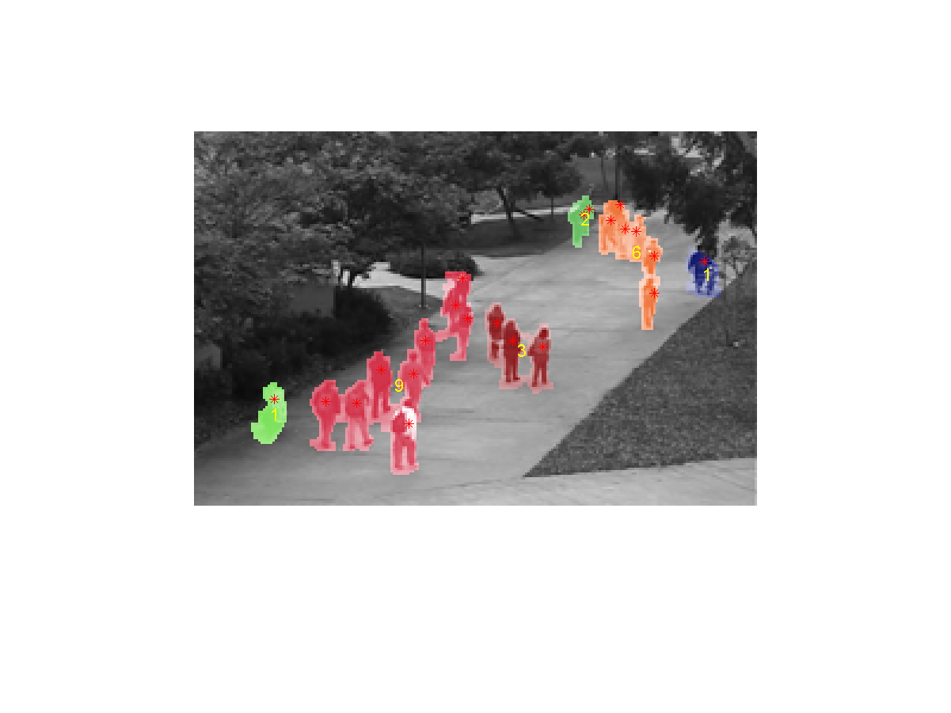
Counting-by-Regression
Estimating the size of a group via extracting low-level features of the corresponding region
Pros
Fast and suitable for roughly estimating the density of a crowd
Cons
Sensitive to occlusions, shadows, and changes of illumination
Notes:
The other category is counting-by-regression.
Methods of this class estimate the size of a group by extracting low-level features of the corresponding region.
Typically, this region is assumed to be yielded by background subtraction approaches.
In general, these methods have several advantages.
For example, they are fast and suitable for roughly estimating the density of a crowd.
Despite these, methods of this category are sensitive to occlusions, shadows, and changes of illumination.
To solve this problem, some researchers make the use of multiple cameras.

Slide 11
Multiview people counting
Averaging multiple human detection results of different cameras [Ma et al., TIST 2012]
Depends greatly on multiple single-view detection results
Unsuitable to handle the scenes with dense crowds and heavy occlusions
Visual knowledge is transferred, but counting error is also propagated

Slide 12
Outline
Introduction
Previous work
Our approaches
Cross-camera blob matching
Two-pass regression
Experiments and results
Conclusions

Slide 13
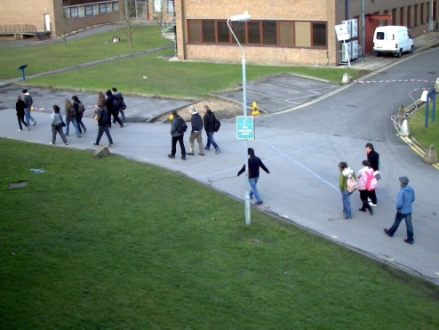
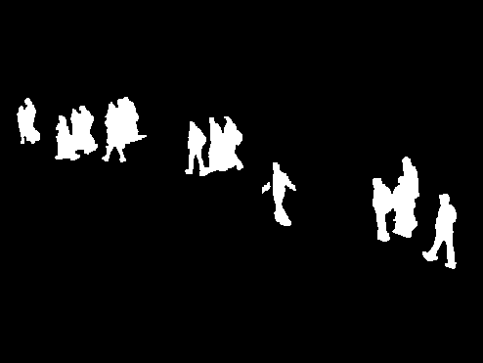
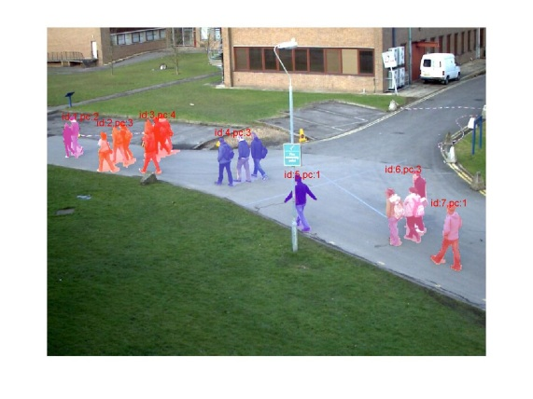
Blob Representation
We focus on foreground objects (pedestrians) in images
Background subtraction
Grouping spatially connected pixels
An input frame
Foreground area
Blobs
Notes:
We propose to make use of visual information from different cameras.
To this end, one of the most important tasks is to match the corresponding blobs among these cameras.
Therefore, visual knowledge can be transferred across cameras.
We represent a video frame by a set of blobs.
A blob here is a group of spatially connected foreground pixels.
To extract foreground blobs, we first apply a background subtraction algorithm to segment out the foreground areas.
Then, spatially connected foreground pixels are clustered to yield the blobs.
As can be seen, each extracted blob in this slide is highlighted by a specific color.

Slide 14
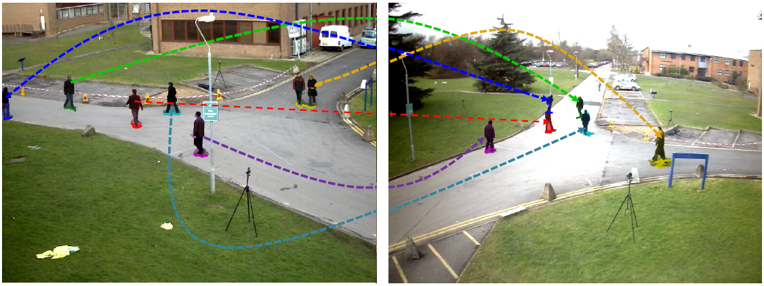
Why Blob Matching
Find the same groups of pedestrians across cameras
Synchronized frames
The numbers of people are not always equal, particularly when FOVs are quite different
We work on corresponding blob sets: blob clusters
Notes:
Once the blobs from all the camera views are extracted, our goal next is to localize and match the corresponding blobs across cameras.
We prefer to work on corresponding blob sets, because using synchronized frames has the following two drawbacks.
First, the numbers of people are not always equal, particularly when the fields of views are quite different.
In addition, working on synchronized frames will produce less training samples.
Therefore, we proposed to work on corresponding blob sets.

Slide 15
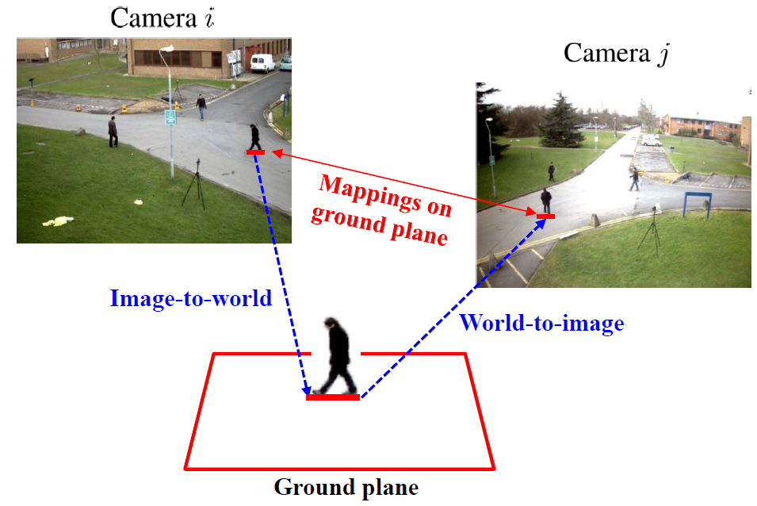
Blob Mapping Methods
Tsai’s camera model [Tsai, JRA’87] and its inverted variant
Use camera parameters to compute the transformation of the ground plane
Map the bottom boundary of each blob
It’s not accurate enough in our cases
Notes:
A naïve blob matching method is to use the given camera parameters to compute the transformation of the ground plane.
Thus, the detected bottom boundary of each blob can be transformed from one image to the other.
However, this approach is not robust, particularly for those pixels do not locate on the ground plane, and often leads to inaccurate matching results.
To improve this, we proposed to use not only ground plane matching but also vertical plane matching.
I will give the details next.

Slide 16
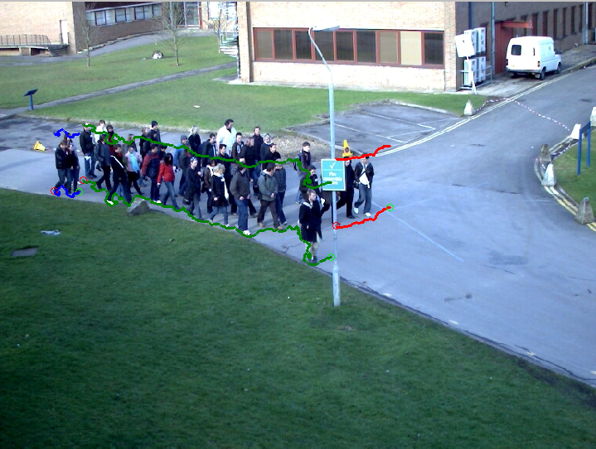
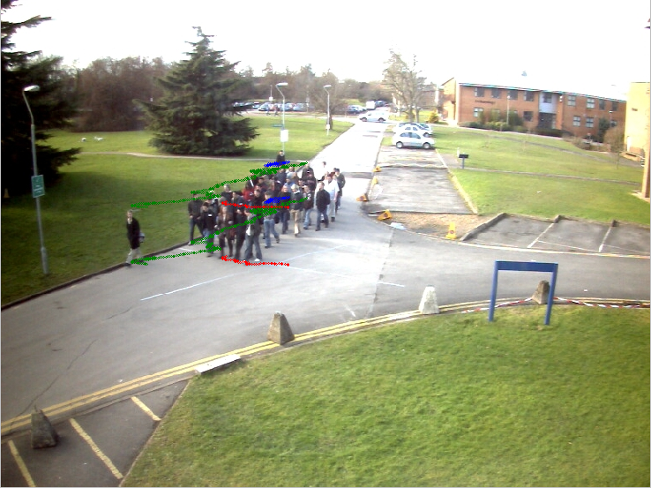
The proposed blob matching
The head position can be inferred by Hoiem’s camera model [Hoiem et al., CVPR’06]
Our method: Ground plane matching + vertical plane matching
Head position
Bottom boundary

Slide 17
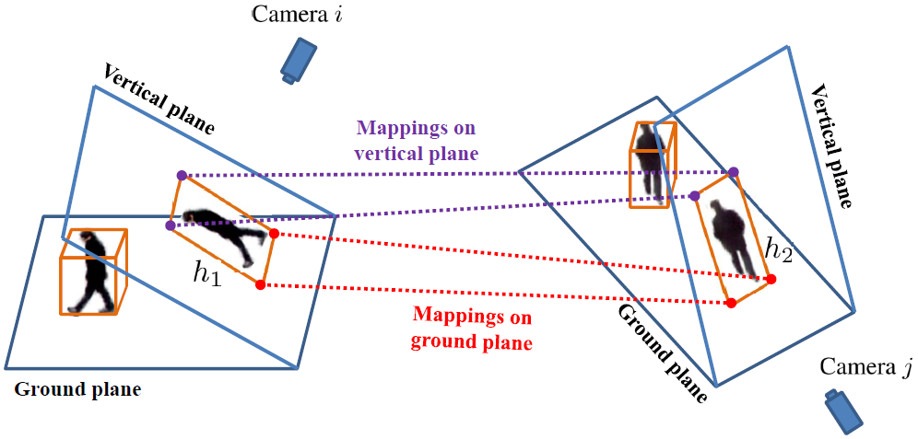
The proposed blob matching (con’t)

Slide 18
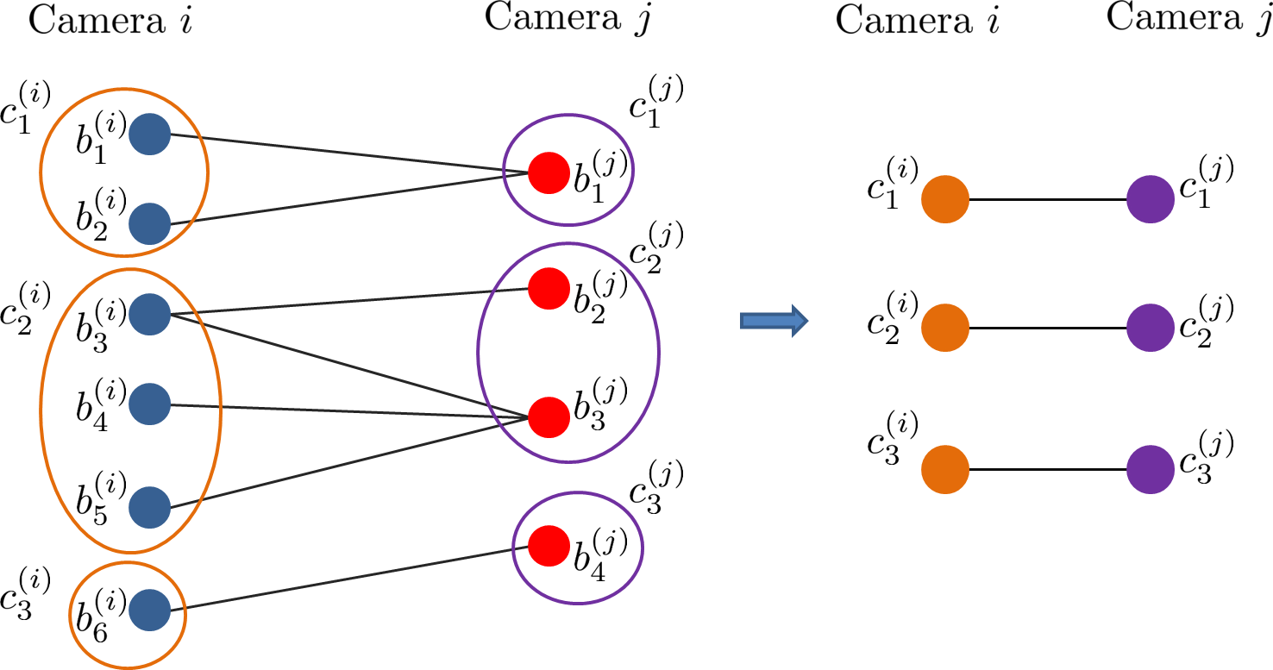
Blob Clustering Algorithm
A bipartite graph representation for blob matching
Node: blob; Edge: blob correspondence
Computing connected components: blob clusters
Blob cluster: the minimal and identical group of pedestrians
blob
blob cluster
Notes:
After the correspondences of blobs between two cameras are established, we can group blobs into blob sets.
We expect that each blob set contains the same entities present in both the two camera views.
We first construct a bipartite graph.
An edge between two nodes in the opposite sides is added if the two corresponding blobs are matched in any direction.
We then perform the connected components in the graph.
In this example, we can see that blob set c-1-I and blob set c-1-J refer to the same group of pedestrians in camera I and camera J, respectively.

Slide 19
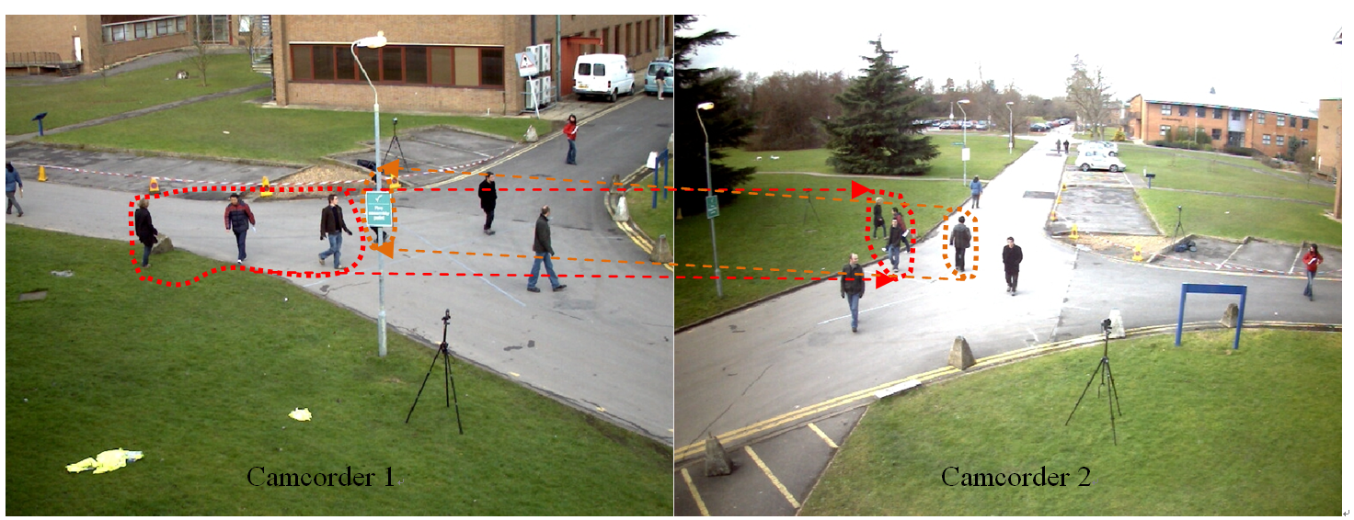
An Example of Blob Clustering Results
Notes:
This is a visualized example of blob clustering results.
We can see that the three blobs in the left image are grouped into a blob set and corresponds to the blob set in the right image.
Since they refer to the same group of pedestrians, it implies that their visual cues can be shared directly.
That is, we propose to transfer visual knowledge across the matched blob sets.

Slide 20
Outline
Introduction
Previous work
Our approaches
Cross-camera blob matching
Two-pass regression
Experiments and results
Conclusions

Slide 21
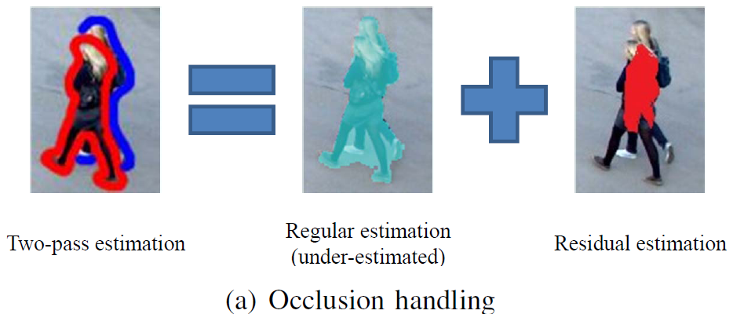
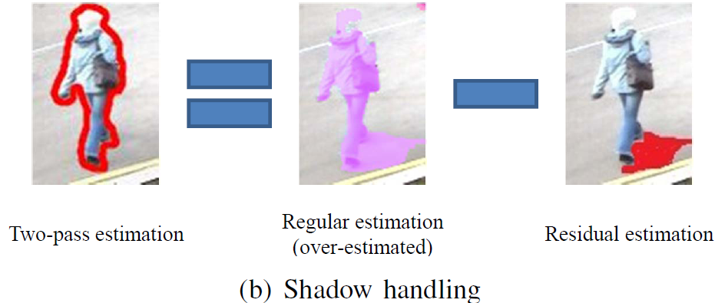
Observation
Approximating the people counts in an image in two parts
Regular part: intra-camera visual features
Residual part: inter-camera visual knowledge

Slide 22
Two-pass regression
First-pass regression
Second-pass regression
# of People
Regular part
Residual part
Intra-camera visual features
Inter-camera view knowledge

Slide 23
Regular-part estimation (First-pass regression)
Regression unit
Blob
Low-level features
Area, Canny edge pixels, and oriented gradients
Learning and regression
Multiple kernel learning + support vector regression

Slide 24
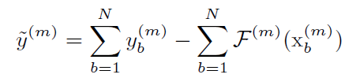
Residual-part estimation (Second-pass regression)
Regression unit: Matched blob cluster (a set of blobs)
Label: The residual yielded in the first pass
Features: Derived from prediction conflicts among different features and different views
Regressor: Multi-kernel support vector regression

Slide 25
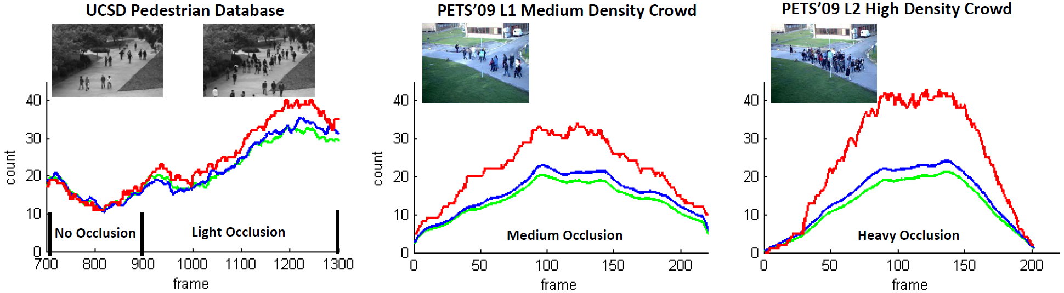
Why predict conflict works
An example: prediction conflict between horizontal and vertical gradients for occlusion handling
Ground truth
Prediction by the feature of horizontal gradients
Prediction by the feature of vertical gradients

Slide 26
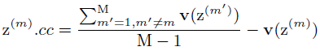
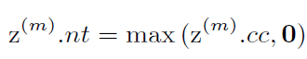
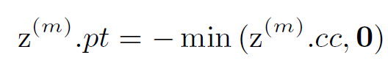
Residual-part estimation (Second-pass regression)
Features: the conflicts of people counts estimated by various features in different cameras
Cross-camera conflict:
Negative trim:
Positive trim:
Intra-camera conflict:

Slide 27
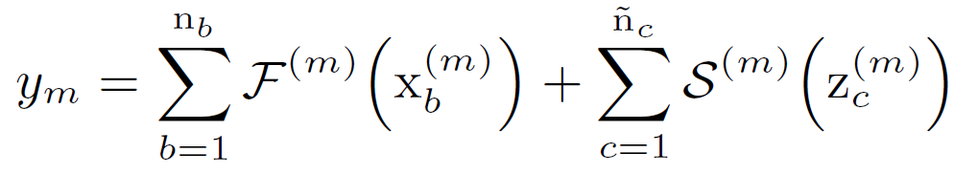
Two-pass People Counting
The number of people in a frame is then estimated by
Regular estimation
Residual estimation
Notes:
After the training procedure, the final regressors of the two passes are available.
In the testing phase, suppose that we are given frames taken by a target camera, and it is of blob representation and blob set representation.
Our approach estimates the number of people in this frame by summing both the regular estimation and the residual estimation.

Slide 28
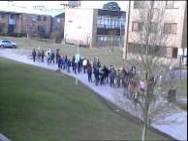
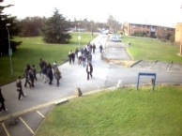
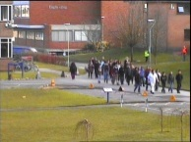
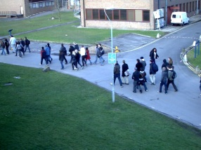
System overview
Auxiliary Views
Blob Matching
Component Representation
Residual-part Estimation
Target View
Blob Representation
Regular–part Estimation
Final Estimation

Slide 29
Outline
Introduction
Previous work
Our approaches
Cross-camera blob matching
Two-pass regression
Experiments and results
Conclusions

Slide 30
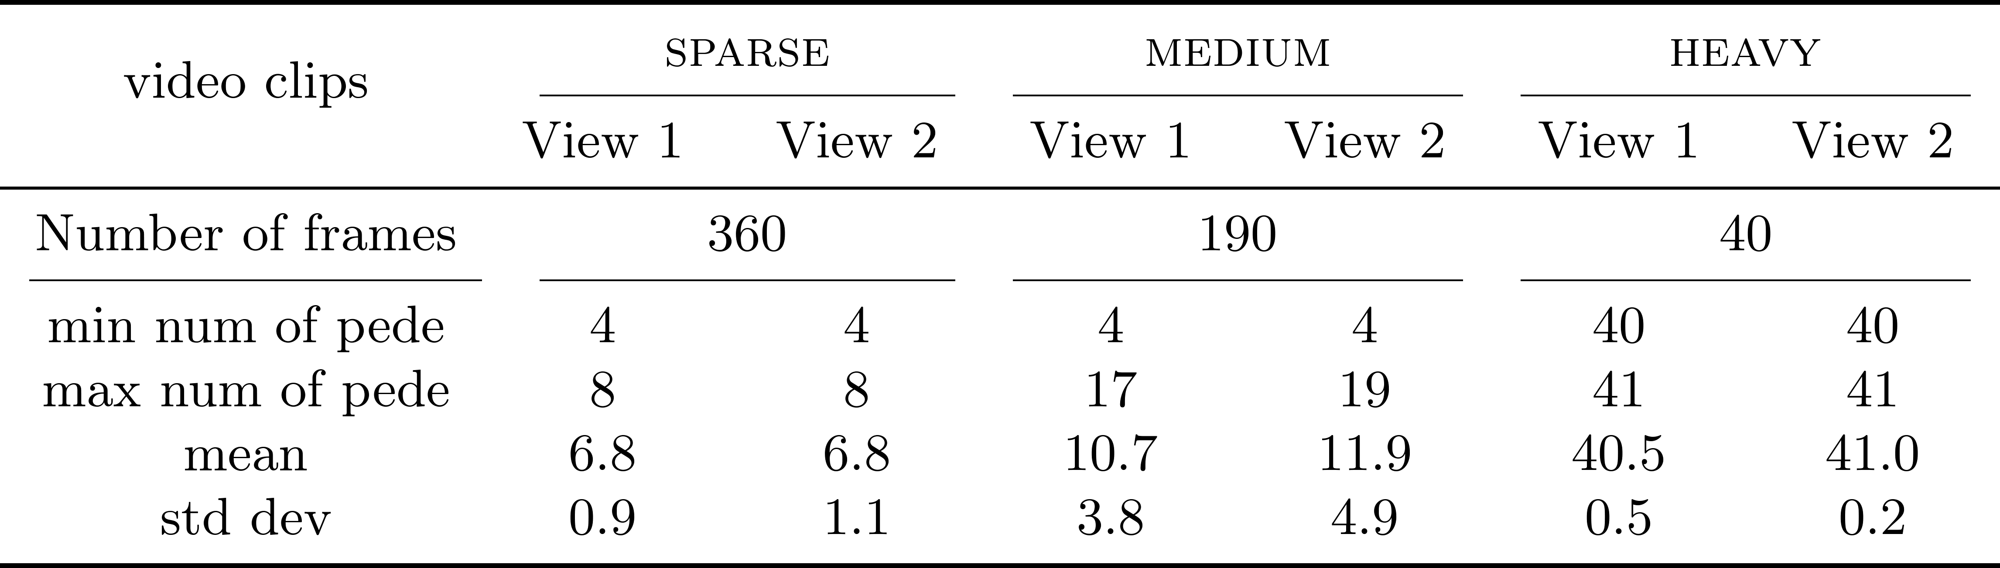
Experimental Settings
PETS 2010 Benchmark Data
Select three representative video clips in two views
Notes:
To evaluate the performance of the proposed system, we conduct experiments on the PETS 2010 Benchmark Data.
This data set consists of a collection of videos captured by several fixed camcorders.
These camcorders are located at different positions and set up to monitor the same scene.
We select three representative video clips of two views.
We denote them as SPARSE, MEDIUM, and HEAVY, respectively.
While SPARSE and MEDIUM are two videos with sparse individuals and small groups of pedestrians, HEAVY generally contains highly crowded groups.
Since these selected videos span a wide spectrum of occlusion levels, collecting them together forms a good test bed.
This table shows the details of our experimental data.

Slide 31
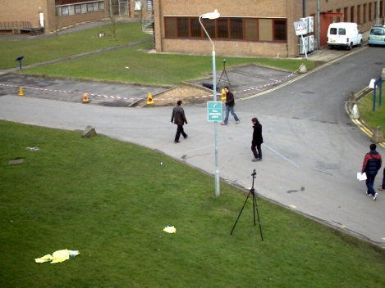
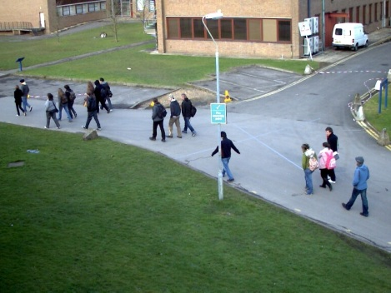
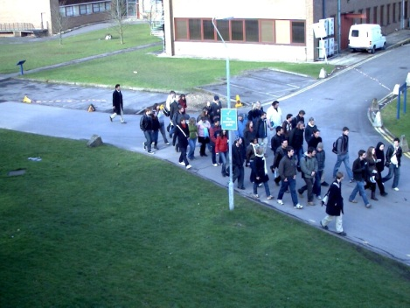
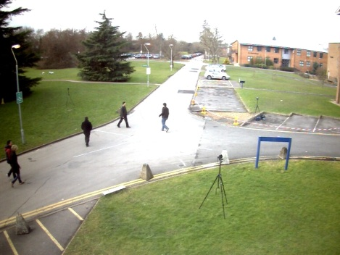
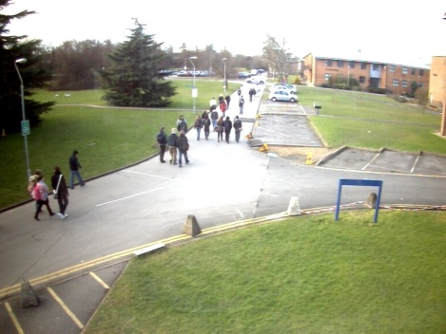
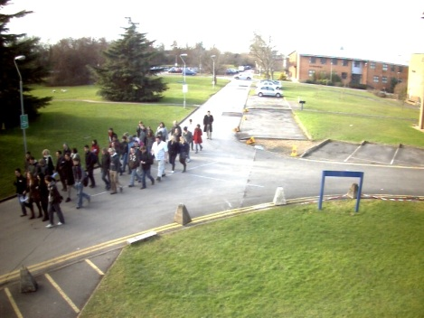
Some video frames in the three videos
SPARSE
MEDIUM
HEAVY
View 1
View 2

Slide 32
Experimental Settings
Each video clip is divided into a non-overlapping training and testing set
Use MAE as the performance metric
Four evaluation settings
Using one video only (HEAVY)
Using a combination of two videos (SPARSE+HEAVY and MEDIUM+HEAVY)
Using all three videos (SPARSE +MEDIUM+HEAVY)
Notes:
For performing quantitative evaluations, we divided each video clip into a non-overlapping training and testing set.
We use the preceding half of frames of each video as training data and report the performance by testing on the remaining frames.
In experiments, we use mean absolute error as the performance metric.
Furthermore, we evaluate the overall performance by the average of mean absolute errors over all evaluation videos.
In addition, we conduct experiments with four different settings to examine the stability of the changes of the training data.
They are, respectively, one using one video only, two using a combinations of two videos, and one using all three videos as training data.

Slide 33
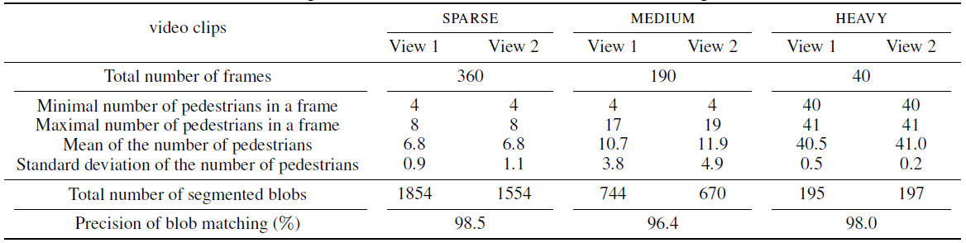
Blob matching accuracy
Experiments on the PETS 2010 dataset
Accuracy: 96.4% ~ 98.5%
Notes:
This table roughly shows the accuracy of our blob correspondence estimation approach.
We conduct experiments on the PETS 2010 dataset.
We observe that the proposed method is able to obtain sufficiently accurate results, ranging from 96% to 98%, over three videos with different crowdedness levels.

Slide 34
Baselines and state-of-the-art Approaches
Counting with a single camera:
BS-MKL: The estimation results yielded in the first stage
GP: Gaussian process method by Chan et al. (CVPR 2008)
NN: Neural network method by Ryan et al. (DICTA 2009)
Counting with multiple cameras:
FRAME-AVG: Averagely combine the estimation results of corresponding frames
COMP-AVG: Averagely combine the estimation results of matched components
OURS: The proposed two-pass regression framework
Notes:
To understand what the proposed system advances other single-camera systems, we use the estimation results yielded in the first stage as our baseline.
We denote it as BS-MKL.
We also implemented a Gaussian process and a Neural Network method.
These two methods represent the state-of-the-art approaches.
We denote them as GP and NN, respectively.
Note that these three approaches merely use intra-camera visual cues and do not involve any knowledge transfer among cameras.
In our current survey, there does not exist any multiple camera people counting system.
Therefore, we use an intuitive way to fuse complementary information for comparisons.
We introduce two fusion manners, frame-based fusion and component-based fusion.
They are denoted as frame-avg and comp-avg, respectively.
Finally, we use OURS to represent our two-pass regression framework.

Slide 35
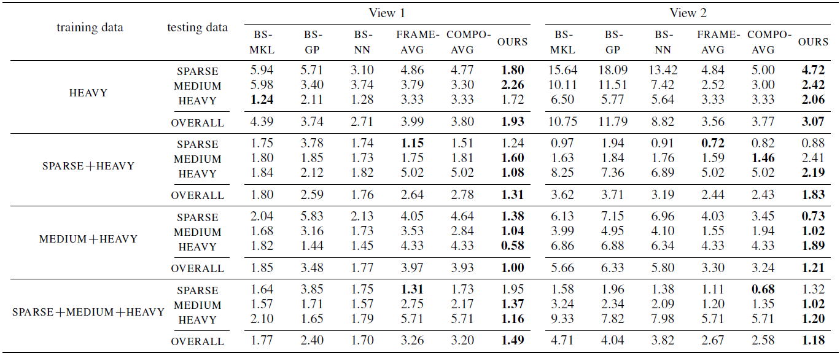
Quantitative Results
Our method reduces the estimation errors of the first pass ranging from 15.8% to 78.6%
Notes:
This table displays the overall quantitative results on the three testing videos.
It not only shows the performance of our system but also comparisons with other methods.
From the table, we can observe that the performance gains of the multiple camera systems using either frame-avg or comp-avg is modest.
This is because this kind of fusion approaches perform an interpolation of the estimations given by different views.
Although this manner may yield higher accuracy, in most cases errors are propagated, thus degrading performance.
In contrast, our system is able to handle this difficulty and achieves significant improvement.
Overall, these experiments show that our method reduces the estimation errors of the first pass ranging from about 15% to about 78%.

Slide 36
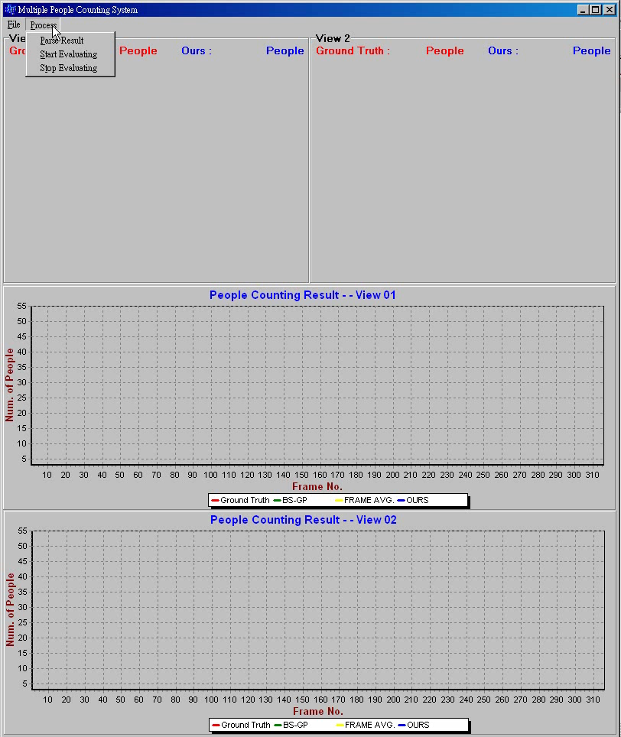
Demo video
PETS benchmark
Two views
Matched blobs are highlighted
Four curves
: Ground truth
: Single-camera BL
: Multi-camera BL
: Ours
Improvement
50% in veiw1
75% in view2

Slide 37
Outline
Introduction
Previous work
Our approaches
Cross-camera blob matching
Two-pass regression
Experiments and results
Conclusions

Slide 38
Remarks
We give the first machine learning algorithm that integrates visual knowledge captured by multiple cameras for people counting
Correspondence between multiple cameras
Grand plane matching + Vertical plane matching
Information fusing: Two-pass regression
Regular part + Residual part
We provide manually annotated pedestrian labels on PETS 2010 dataset.
Available in http://research.twnct.net/MCPC_MM2012/

Slide 39


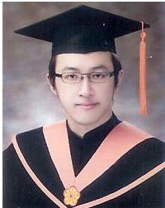

References & Acknowledgement
Related papers:
T.-Y. Lin, Y.-Y. Lin, M.-F. Weng, Y.-C. Wang, Y.-F. Hsu, and H.-Y. M. Liao, "Cross Camera People Counting with Perspective Estimation and Occlusion Handling," IEEE International Workshop on Information Forensics and Security (WIFS), 2011.
M.-F. Weng, Y.-Y. Lin, N. C. Tang, and H.-Y. M. Liao, "Visual Knowledge Transfer among Multiple Cameras for People Counting with Occlusion Handling,” ACM International Conference on Multimedia (MM), 2012
Collaborators
Mr. Tsung-Yi Lin
Dr. Ming-Fang Weng
Dr. Nick C. Tang
Prof. Mark Liao

Slide 40
Thank You!
Email: yylin@citi.sinica.edu.tw

